Slide 1
Scenic Design

Slide 2
Types of design
There are 3 types of design
Box set
Unit set
Suggested set

Slide 3
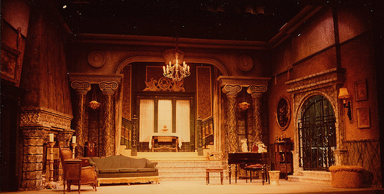
Box Set
Usually involves walls that enclose the playing space
Sets are usually realistic and detailed.
Most modern sitcoms you see on tv are box sets.
https://c1.staticflickr.com/3/2730/4100174698_0f8e5cc391.jpg

Slide 4
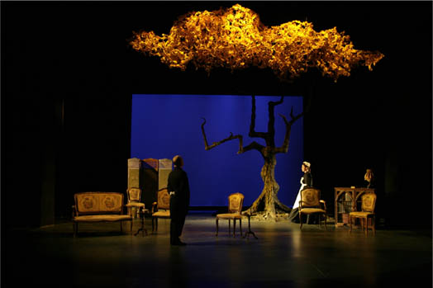
Unit Set
Composed of units that can be moved on and off stage
Most unit sets are aesthetically supported by drops, lit backgrounds or projections
Most musicals are considered unit sets.
http://www.fionawatt.com/images/design-8.jpg

Slide 5
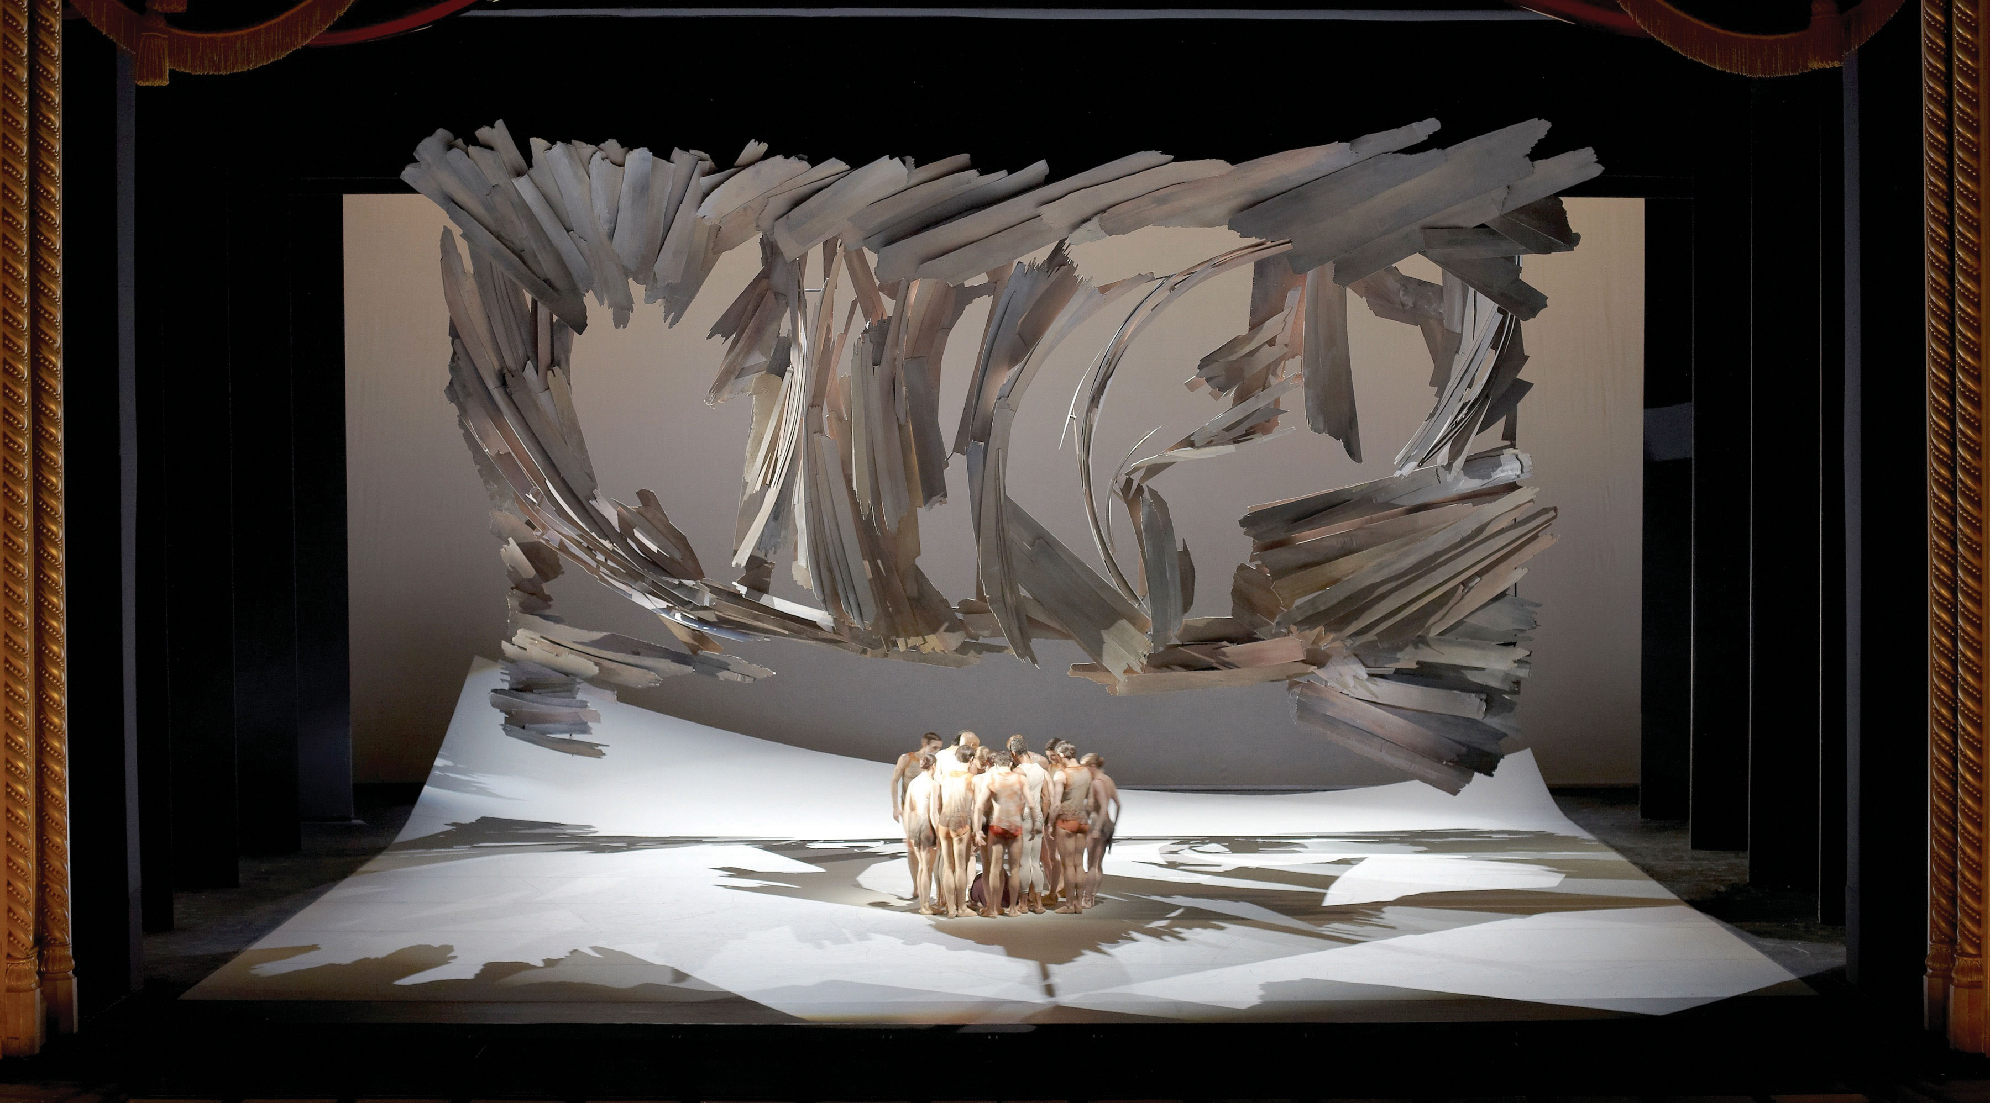
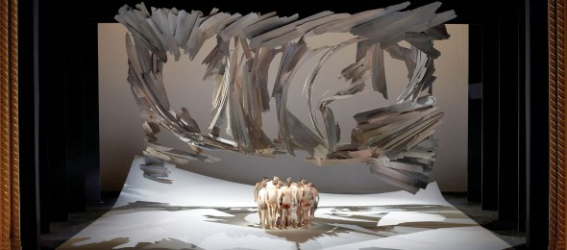
Suggested set
Just as the name says these are suggested environments
Ideal design for modern plays that may be concept and theme driven
http://www.internationalartsmanager.com/2013/06/wsd-2013-brings-stage-designers-to-cardiff/

