Slide 1
Performance Spaces

Slide 2
Types of performance spaces…
A designer must consider the type of stage/space the performance
will take place in.
There are
Amphitheatre
Proscenium stage
Theatre in the round or arena stage
Thrust stage
Traverse stage
Promenade stages
End on stage
Invisible theatre
Immersive theatre

Slide 3
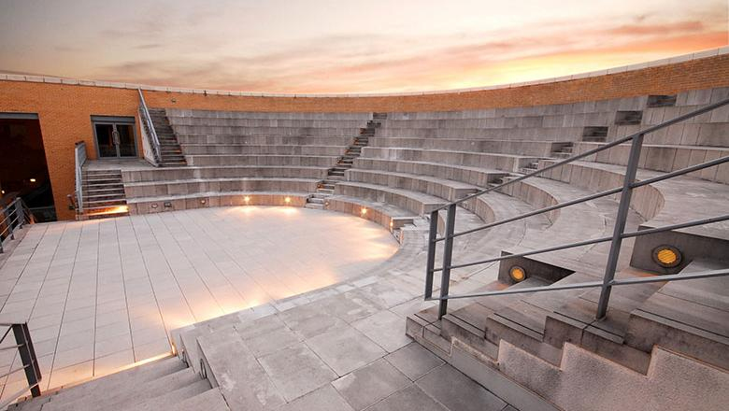
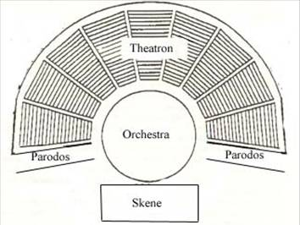
Amphitheatre
An amphitheatre is an open-air venue used for entertainment, performances, and sports. The term derives from the ancient Greek ἀμφιθέατρον (amphitheatron), from ἀμφί (amphi), meaning "on both sides" or "around" and θέατρον (théātron), meaning "place for viewing".
an amphitheatre is a curved, acoustically vibrant performance space, particularly one located outdoors.
https://en.wikipedia.org/wiki/Amphitheatre
http://www3.northern.edu/wild/th100/GreekTheaPlan.jpg
http://www.sbs.ox.ac.uk/sites/default/files/styles/780x440/public/content-images/school/gallery/16-amphitheatre.jpg?itok=IOhZk4Fl

Slide 4
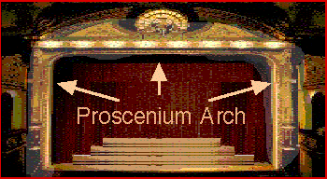
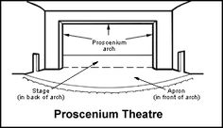
Proscenium stage
The audience sit face on to the stage.
The stage is framed by the arch.
There may or may not be an apron.
http://www.awolacting.com/images/arch.gif
https://s-media-cache-ak0.pinimg.com/236x/e5/e4/99/e5e499ab7ca3c762b097b8837ffc8dd0.jpg

Slide 5
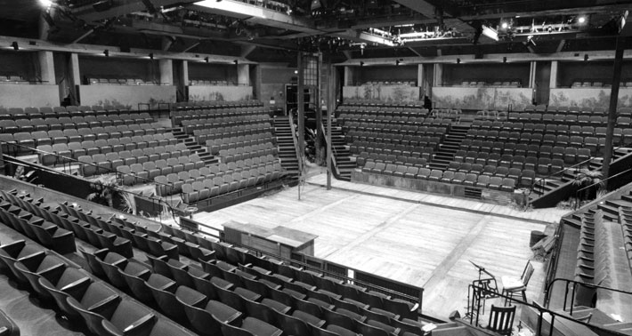
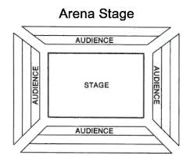
Theatre in the round or arena stage
The audience sit surrounding the entire stage.
This reduces the barrier between audience and the actors – the audience feel as if they are part of the play. It makes for intense and exciting theatre.
https://cassstudio6.files.wordpress.com/2012/12/arena-stage-diagram.jpg
http://www.arenastage.org/about/images/marquee-history-5.jpg

Slide 6
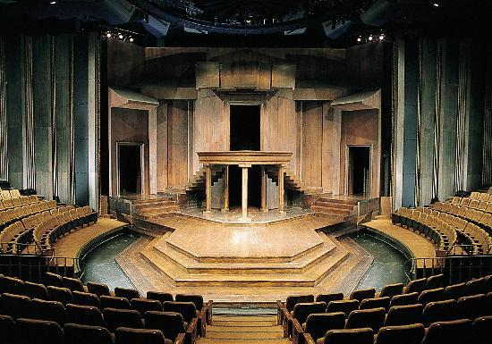
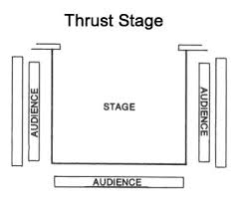
Thrust stage
A thrust stage is a performance space in which the stage breaks through and extends well past the proscenium arch. It reaches out into the auditorium, so that it is surrounded on three sides by the audience.
This was used in Elizabethan times (Shakespeare performed on this type of stage)
https://coffeeandshakespeare.files.wordpress.com/2011/10/thrust-stage-floorplan.jpg
http://media-cdn.tripadvisor.com/media/photo-s/02/4c/f8/f3/festival-theatre.jpg

Slide 7
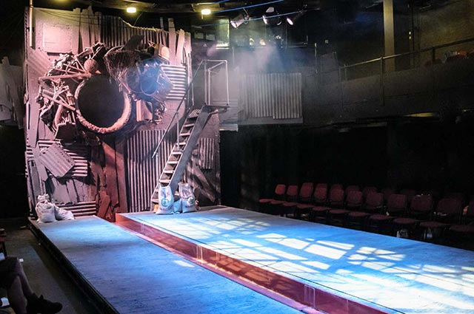
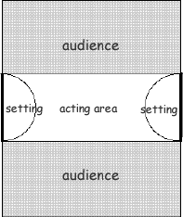
Traverse stage
Traverse is a form of catwalk – though in its purest form it does not have the stage and back wall area that a fashion catwalk has.
The audience sits on two sides of the stage.
http://4.bp.blogspot.com/-iuk6QKAxSvs/VCbKbLK61SI/AAAAAAAAAAo/hphJhGqX7EU/s1600/traverse2.gif
http://www.wsd2013.com/wp-content/uploads/gravity_forms/3-799e347713bcded6eb29273b86d688c6/2013/03/goodsoulpipe.jpg

Slide 8
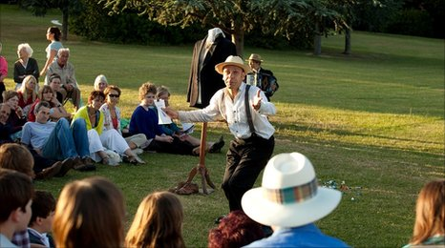
Promenade
Designed to be performed at a unique, specially adapted location other than a standard theatre (for example, in a hotel, courtyard, or converted building), or may simply be considered an unconventional theatre space (for example, in a forest).
There may be a number of different stages set up in different areas.
The audience may be expected to walk or move about (rather than sit).
1
2
3
http://news.bbcimg.co.uk/media/images/48237000/jpg/_48237640_-1.jpg

Slide 9
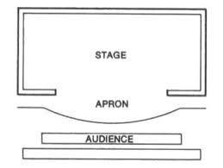
End on Stage
Similar to a proscenium but there is no framework. The stage stretches across the
width of the auditorium and there are no curtains.
All scene changes are done in full view of the audience.
Actors play to the front.
The back wall can be used for scenery.

Slide 10
Invisible Theatre
Invisible theatre is a form of theatrical performance that is enacted in a place where people would not normally expect to see one (for example in the street or in a shopping centre) and often with the performers attempting to disguise the fact that it is a performance from those who observe and who may choose to participate in it, thus leading spectators to view it as a real, unstaged event.
https://en.wikipedia.org/wiki/Invisible_theater

Slide 11
Immersive Theatre
Immersive Theatre is all about creating participative theatre experiences in which audience members give up their “observer’’ status to become co-actors and co-creators of the narrative and of the storytelling process. The audience members may direct the story by taking decisions, choosing from infinite options and negotiating the process. Audience will be inside the space, walking through site-specific installations, choosing what scenes to see, changing and elaborating the text, creating movements and physically responding to actions to create site-responsive theatre. The performance will never be the same.
https://immersivetheatre.com/about/

